Slide 1


© 2014 Microsoft Corporation. All rights reserved. Microsoft, Windows, and other product names are or may be registered trademarks and/or trademarks in the U.S. and/or other countries.
The information herein is for informational purposes only and represents the current view of Microsoft Corporation as of the date of this presentation. Because Microsoft must respond to changing market conditions, it should not be interpreted to be a commitment on the part of Microsoft, and Microsoft cannot guarantee the accuracy of any information provided after the date of this presentation. MICROSOFT MAKES NO WARRANTIES, EXPRESS, IMPLIED OR STATUTORY, AS TO THE INFORMATION IN THIS PRESENTATION.

Slide 2

Microsoft
DevCamp
Cross Platform Development

Slide 3

Universal Windows Platform
Wherever your code was born, you can bring it to Windows
Windows Platform
Web Platform
Universal Windows 8 Apps (C++/C#/JS)
Microsoft Edge HTML Engine
Universal Windows 10 Apps (C++/C#/JS)
Surface Hub
Desktop
Cordova Tooling (HTML/JS)
“Project Centennial” (Classic Apps)
“Project Westminster” (HTML/JS)
Universal Windows Platform
IoT
Xbox
Middleware Platforms
Other Mobile Platforms
Middleware Partners (e.g., Xamarin)
Holographic
Mobile
“Project Astoria” (Java/C++)
Game Engine Partners (e.g., Unity)
“Project Islandwood” (Objective C/C++)

Slide 4
Universal Windows Platform
Wherever your code was born, you can bring it to Windows
Windows Platform
Web Platform
Web Platform
Universal Windows 8 Apps (C++/C#/JS)
Microsoft Edge HTML Engine
Microsoft Edge HTML Engine
Universal Windows 10 Apps (C++/C#/JS)
Surface Hub
Desktop
Cordova Tooling (HTML/JS)
Cordova Tooling (HTML/JS)
“Project Centennial” (Classic Apps)
“Project Westminster” (HTML/JS)
“Project Westminster” (HTML/JS)
Universal Windows Platform
IoT
Xbox
Other Mobile Platforms
Middleware Platforms
Other Mobile Platforms
Middleware Platforms
Middleware Partners (e.g., Xamarin)
Holographic
Mobile
“Project Astoria” (Java/C++)
Middleware Partners (e.g., Xamarin)
“Project Astoria” (Java/C++)
Game Engine Partners (e.g., Unity)
“Project Islandwood” (Objective C/C++)
Game Engine Partners (e.g., Unity)
“Project Islandwood” (Objective C/C++)

Slide 5
“Project Astoria” Universal Windows Platform Bridge for the Android Runtime

Slide 6
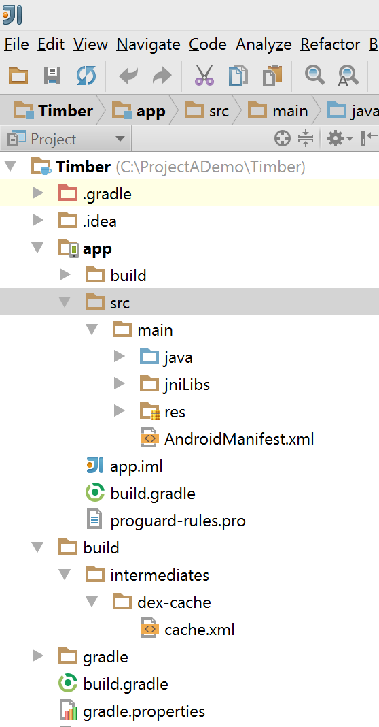
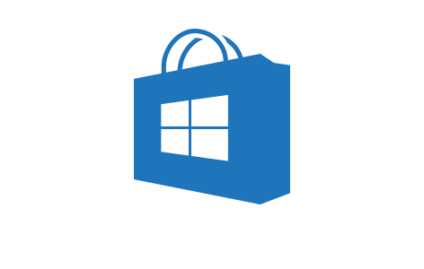



Project Astoria
Build a Windows app with your Android code
Your Android Code
(Project Astoria SDK & App analysis)
Your IDE
(Project Astoria Plugins)
Your dev
machine
Windows
Magic
Your app in the Windows Store
IntelliJ
Android
Studio
Eclipse
Live tiles
Windows
Mac
+
+
+
…
Learn more about Project Astoria at http://aka.ms/projectastoria
Windows 10 Mobile Only

Slide 7





Windows does the heavy lifting for you
We translate and redirect Android concepts to Windows concepts
Sharing
Notifications
File system
Camera
User experience
Cloud services
Platform
Acquisition
Input and interaction
App-to-app interactions
Windowing & navigation
Notifications and live tiles
…
In-App Purchases
Ads
Maps
Game Services
Analytics
Notification service
…
File system
Contacts, photos,…
Sensors
Camera
Hardware accelerated graphics & Direct X
…

Slide 8
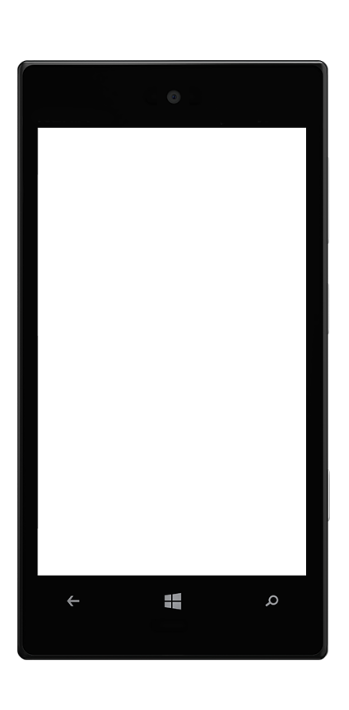
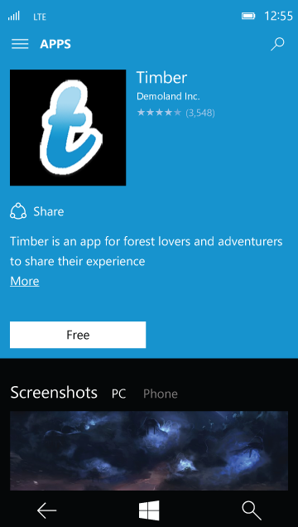

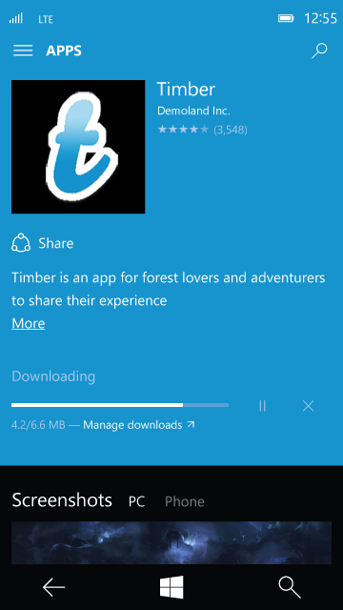
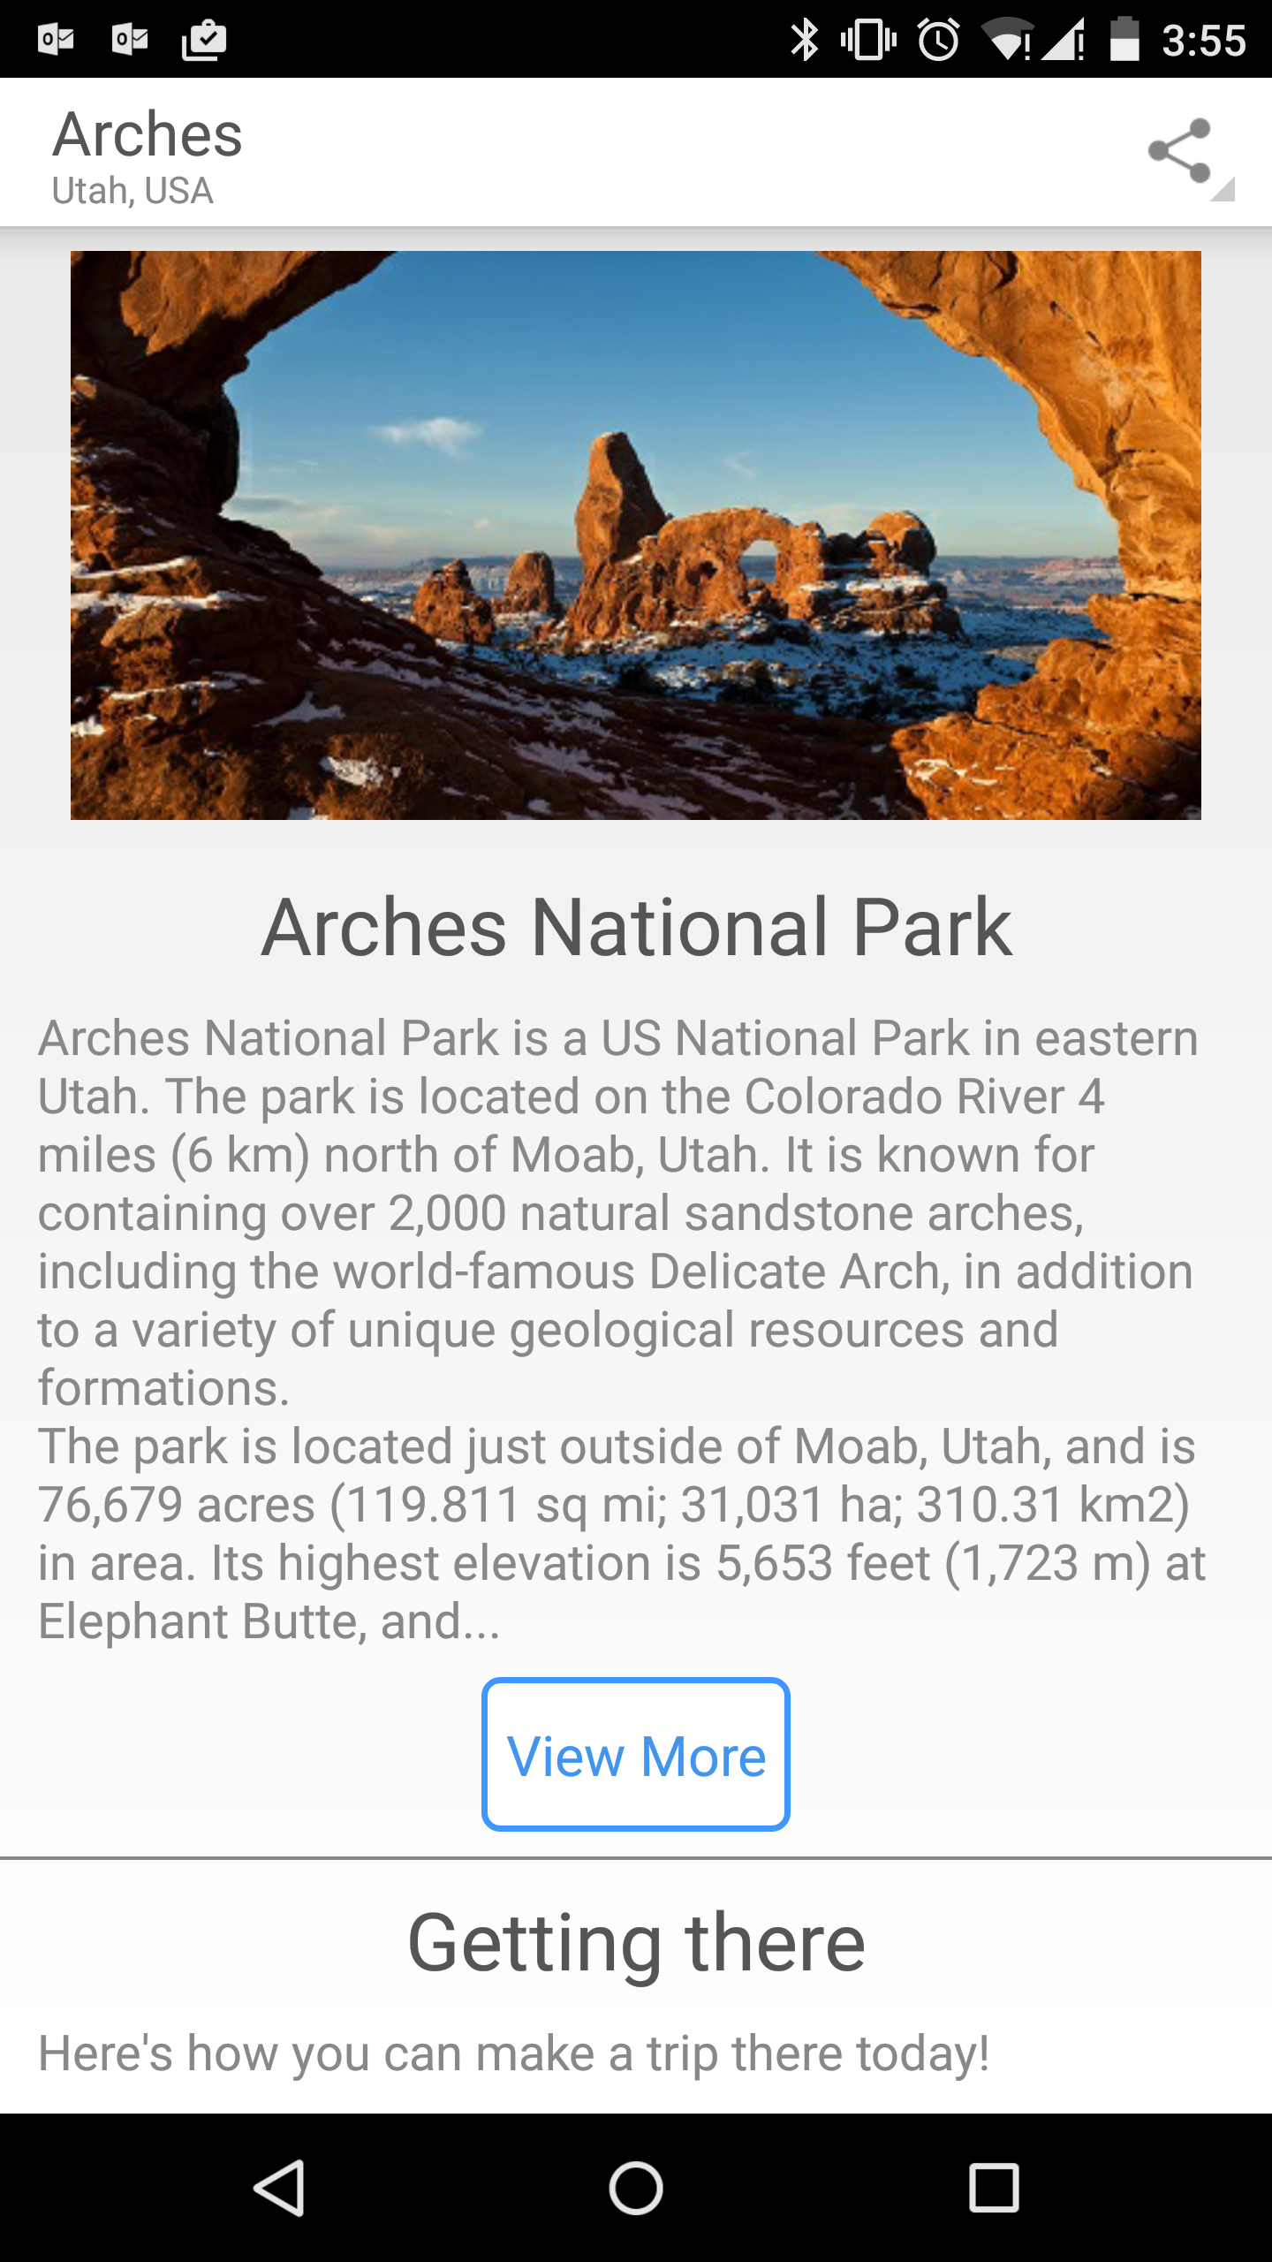
User experience
User experience
Cloud services
Apps built with Project Astoria are Windows apps
Platform
Contoso
Users acquire apps built with Project Astoria through the Windows Store

Slide 9
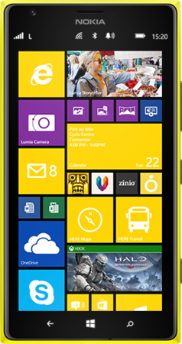
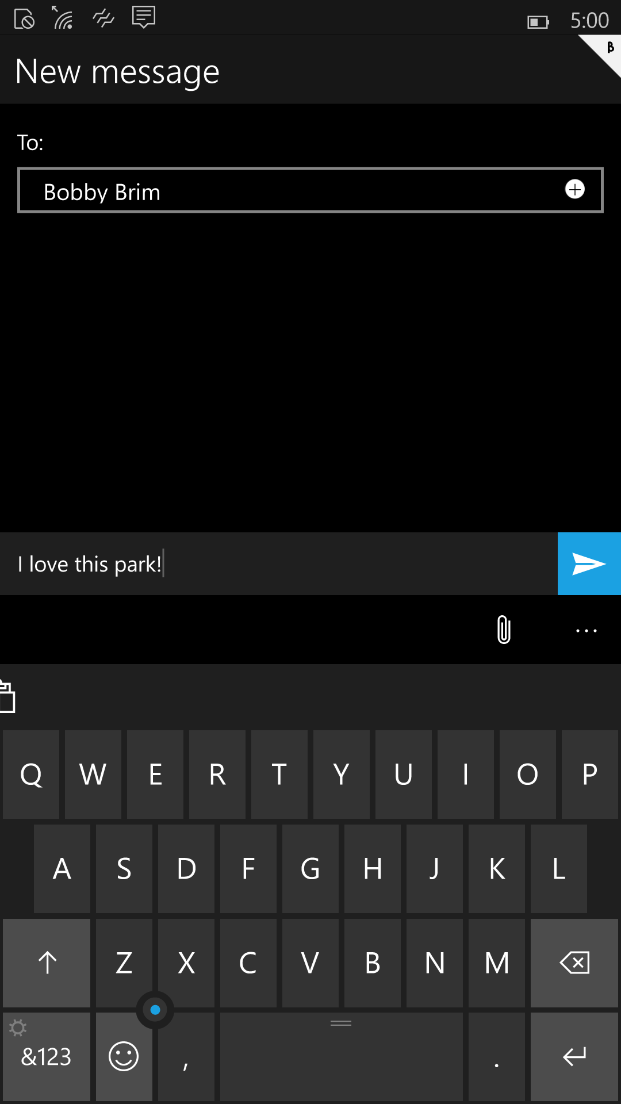
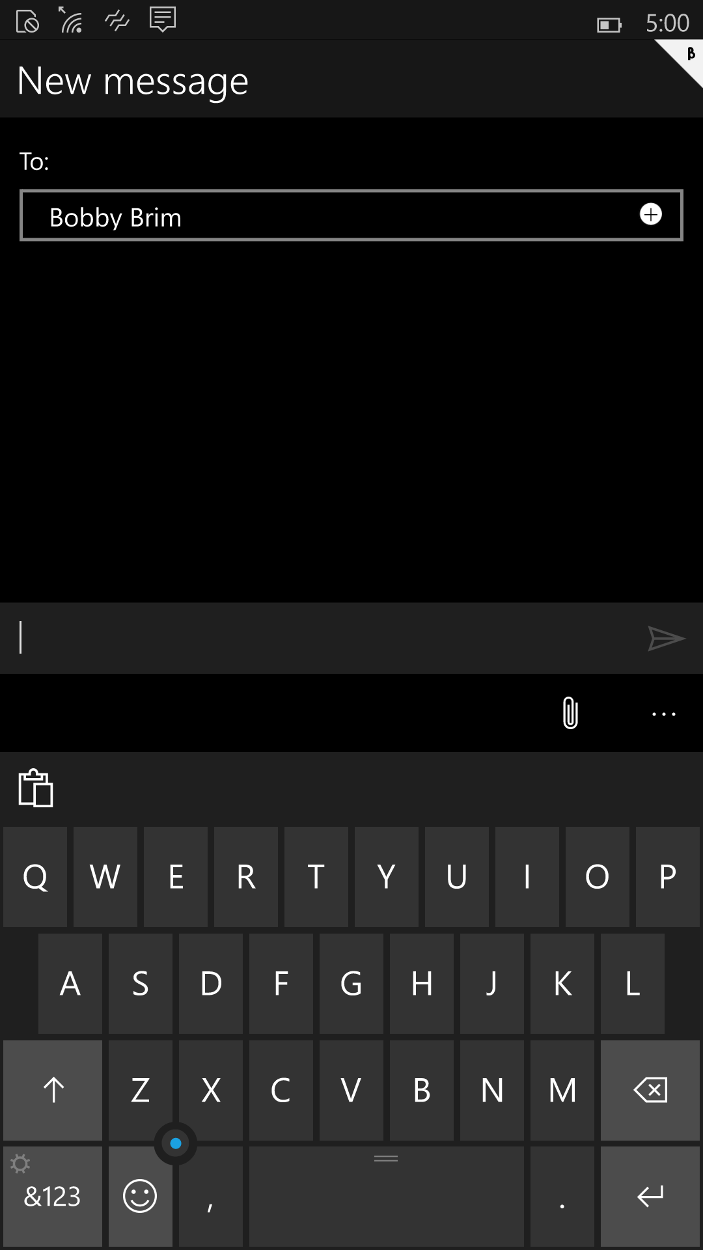
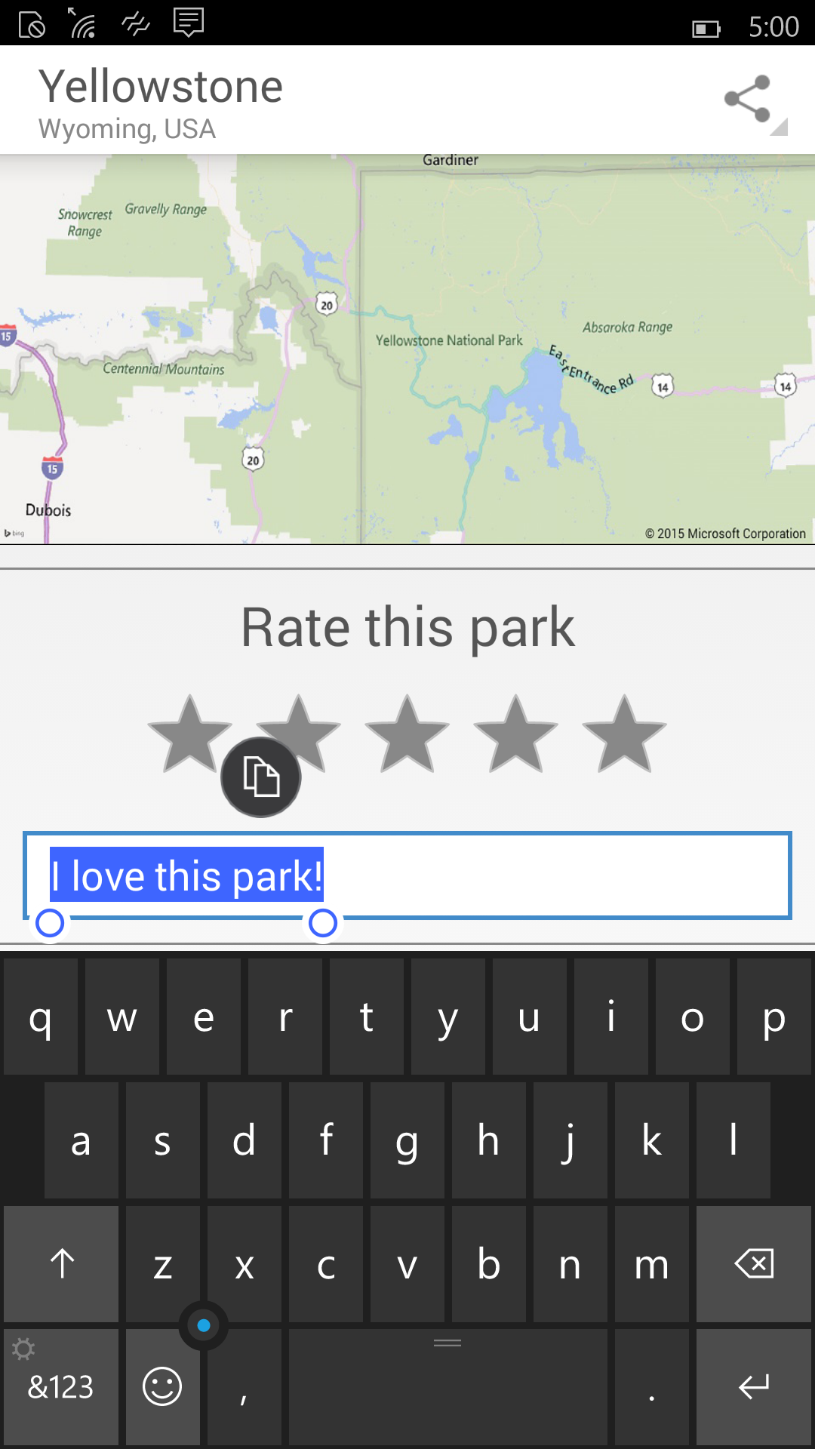
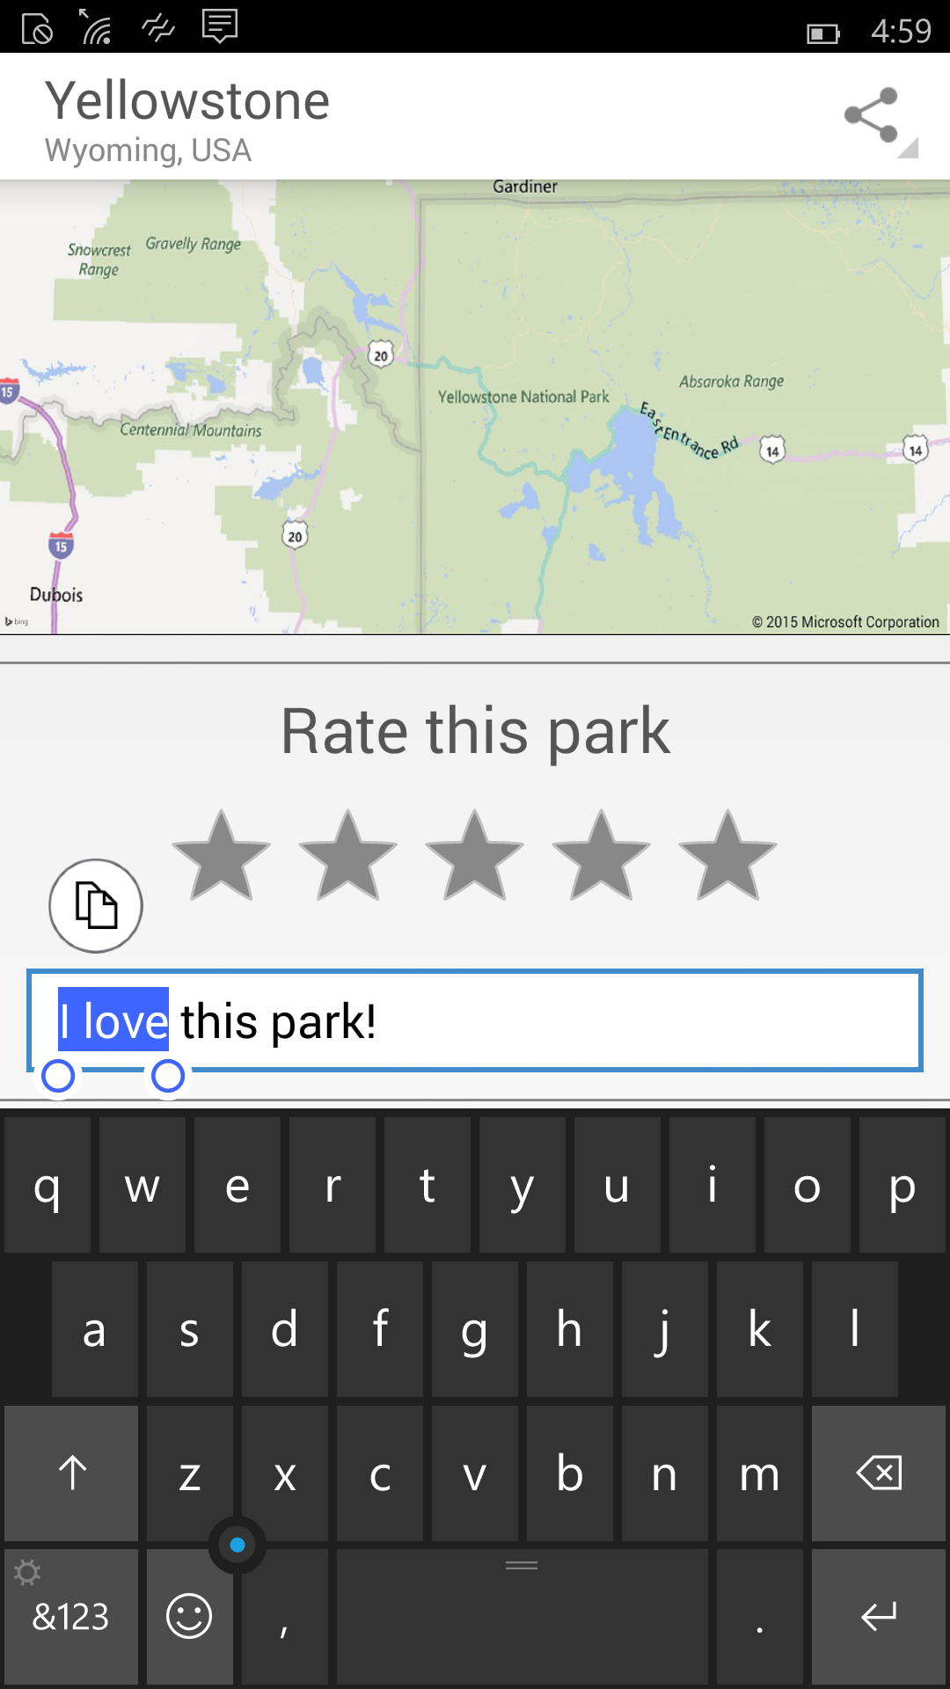
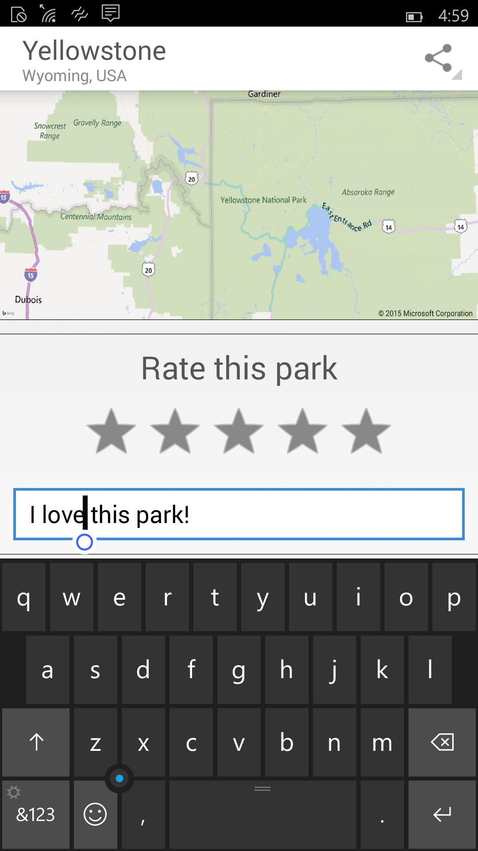
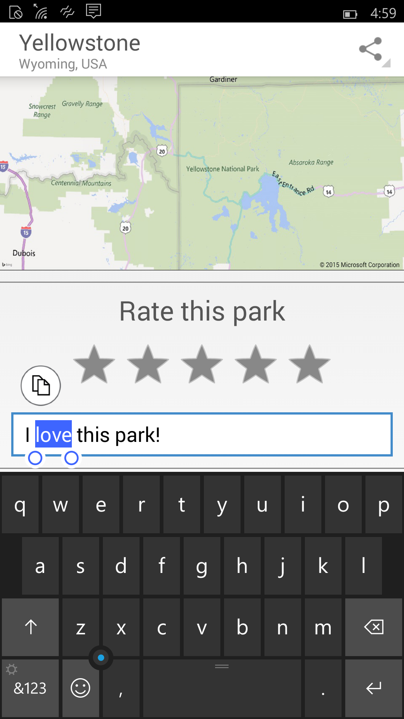
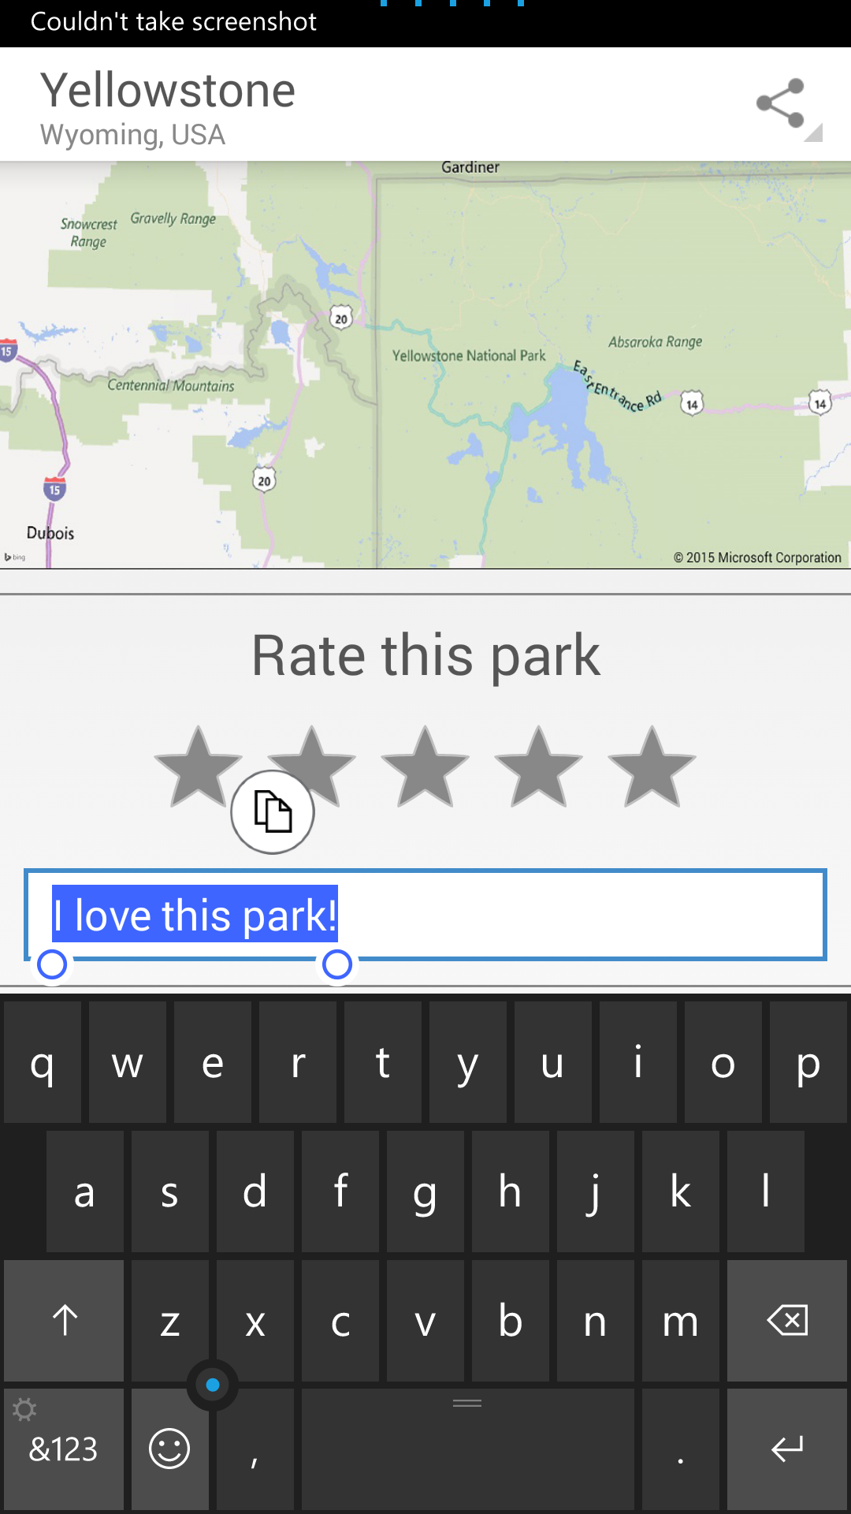
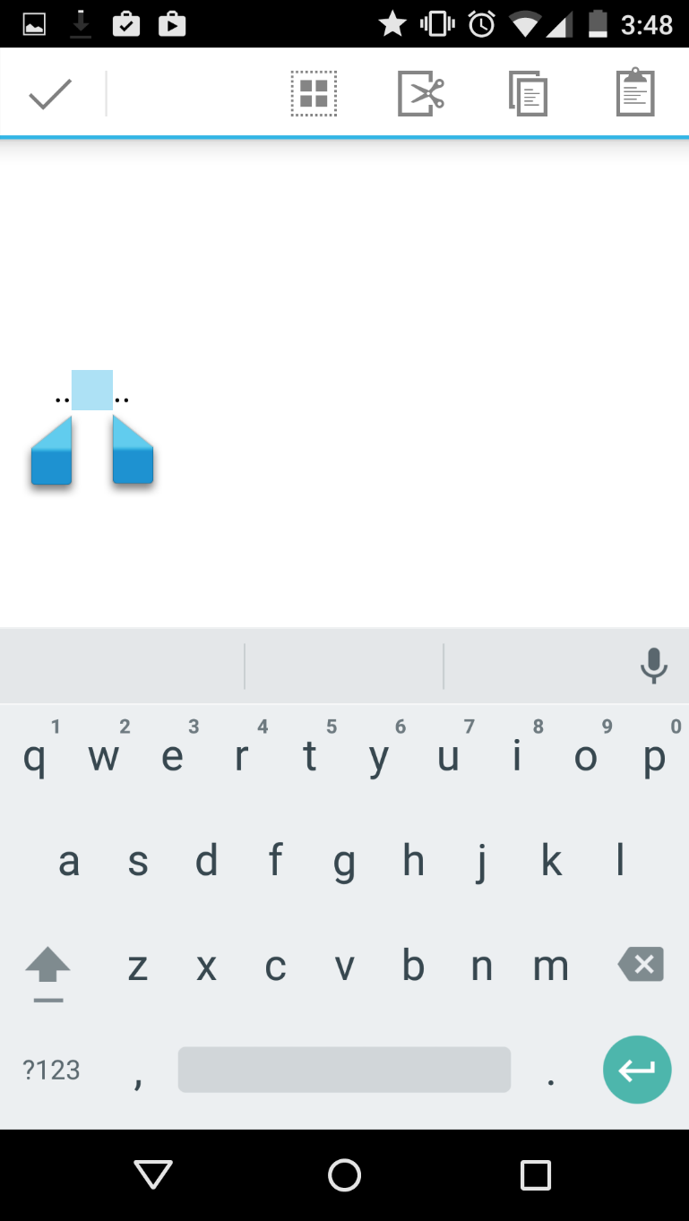
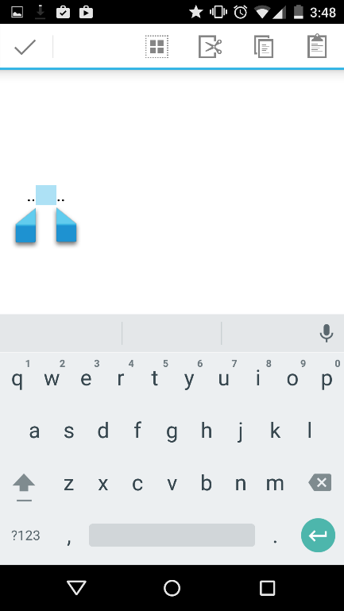
User experience
User experience (cont’d)
Cloud services
Apps built with Project Astoria are Windows apps
Platform
v/s
v/s
v/s

Slide 10
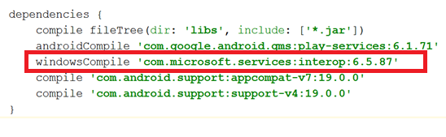
User experience
Cloud services
Cloud services
Windows apps built with Project Astoria use Microsoft cloud services
Platform
Microsoft Services
AppInsights
MS Ads
In-app Purchases
Windows Notification Service
Xbox Live Services
Bing Maps
Windows Location services
…
Project Astoria SDK in Java
Use Microsoft services with minimal code change
Get Started in Dev Center
Notes:
Flavors

Slide 11
User experience
Platform redirection
Cloud services
Android platform capabilities are redirected to Windows
Platform
APPX
APK
File system
Contacts, photos,…
Sensors
Camera
Hardware accelerated graphics & Direct X
Networking/sockets
Application lifecycle
Resource management
Background execution model
Security model
“PROJECT ASTORIA” SUBSYSTEM
WINDOWS

Slide 12
User experience
Performance and Battery
Cloud services
Platform
APPX
APK
Windows resource management
Runs directly on top of Windows kernel
“PROJECT ASTORIA” SUBSYSTEM
WINDOWS

Slide 13
User experience
A trustworthy user experience
Cloud services
Keeping users safe
Platform
Trusted Store
Secure Device
Monitoring & Response

Slide 14
“Project Islandwood” Universal Windows Platform Bridge for iOS

Slide 15


Candy Crush Saga: Brought to Windows Phone with very few code changes

Slide 16
Write Universal Windows Apps in Objective-C
What is Project Islandwood?
Objective-C language support
Compiler and Runtime
Useful and usable APIs
iOS API compat
Tools
Editor / Workflow
Project import

Slide 17
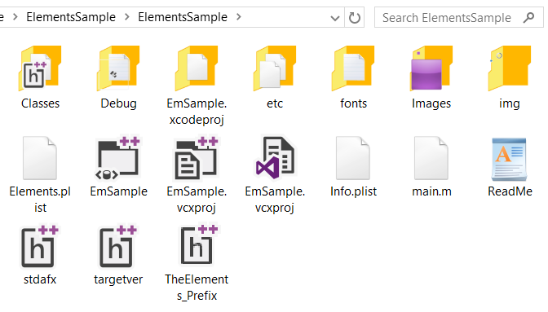
Tooling
Xcode projects imported to Visual Studio
Shared project settings, imported from Xcode

Slide 18
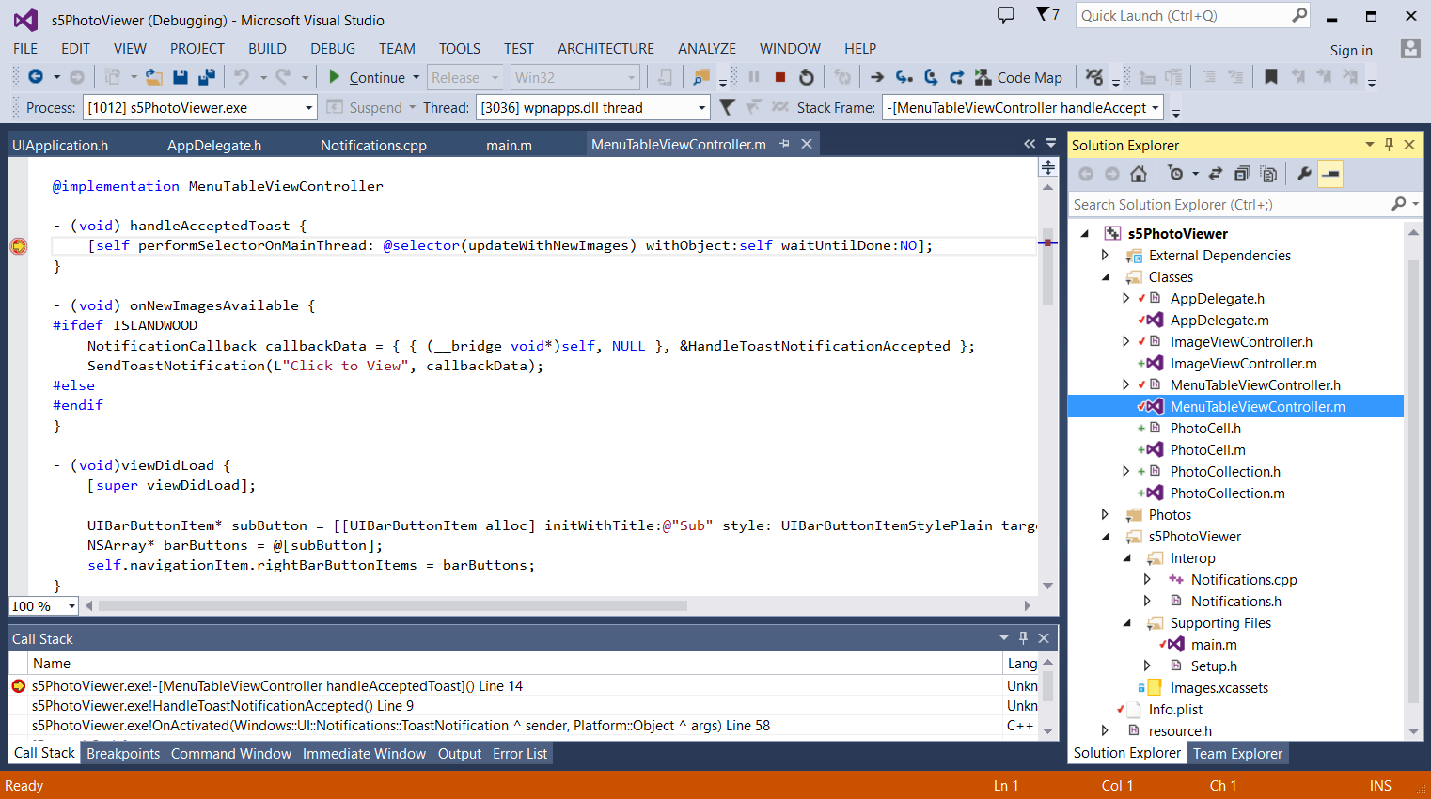
Tooling
Integrated Visual Studio Development
Integrated language support: syntax highlighting, autocomplete
Xcode projects imported to Visual Studio
Universal API Interop
Full debugging: breakpoints, stack traces, …
Notes:
Not limited to fixed screen sizes: UIApplicationStartupMode category for startup conditions
OperationMode for form factor
appBackButtonPressed: callback for physical back button

Slide 19
“Project Westminster” Universal Windows Platform Bridge for Web Apps

Slide 20
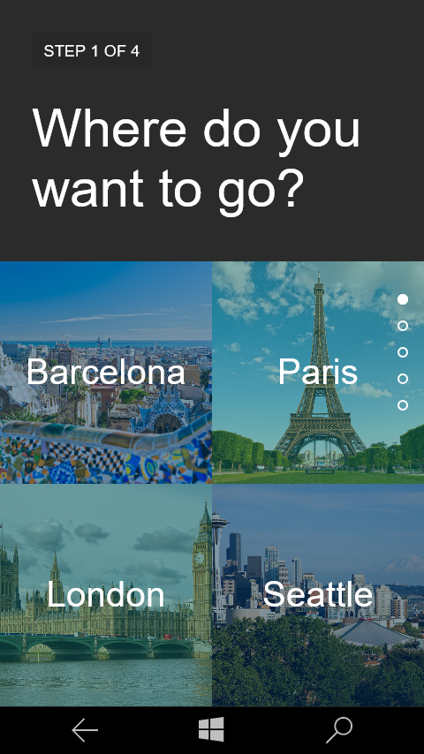
Keep your web workflow for updating content
Use your editor
Push to your repo’s
Deploy on your service
Reach Windows users
Code
Visual Studio
Notepad++
Brackets
Vim
ATOM
Sublime Text
Emacs
Push
Git
SVN
Visual Studio Online
GitHub
Bitbucket
Gitlab
Host
Amazon WS
Heroku
Parse
Private Cloud
Microsoft Azure
Release

Slide 21
XML Manifest URI Allow List
WindowsRuntimeAccess=
"all" Match="https://*.websites.net/"
"allowForWebOnly" Match=https://*.website.net/
Developers can control the Universal APIs they want to expose
"none" Match="http://ads.website.net/"
Default is no access

Slide 22
Packaged JavaScript Apps

Slide 23
Packaged JavaScript Apps
Native HTML5/JS apps on Windows
Copy and paste your server code locally
WebView can still navigate to remote content
Leverage the Edge rendering engine
Always up-to date
New security model using Content Security Policy
More frameworks just work

Slide 24
WebView Control

Slide 25
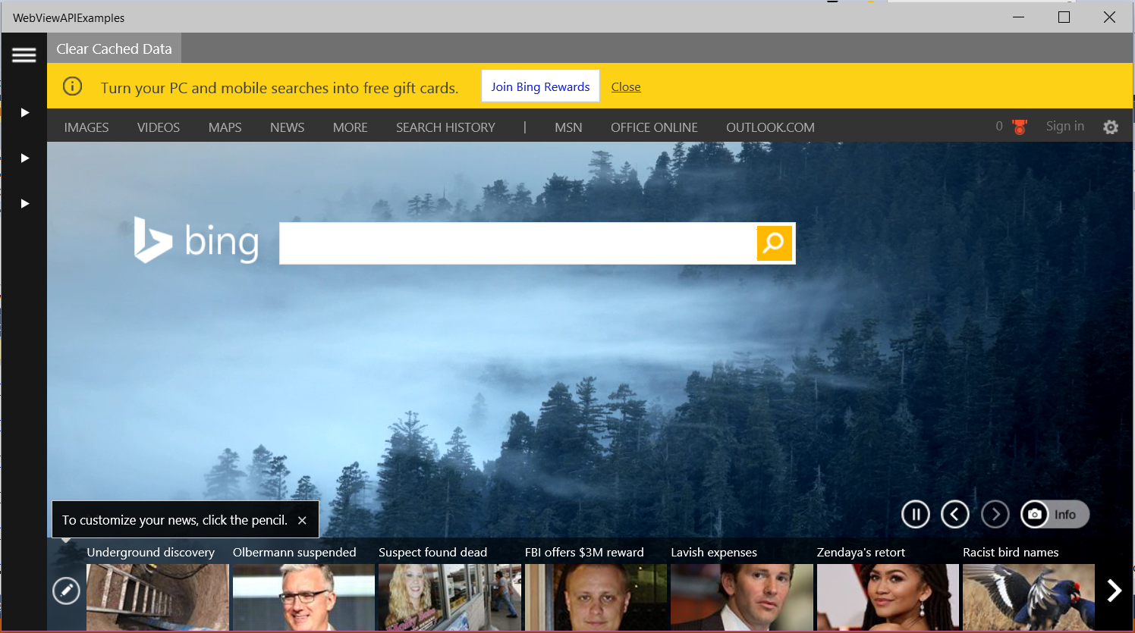
WebView Control
Uses the always current Edge rendering engine
Great for HTML5 and the modern web
Rich API Set
Aimed towards a powerful in App Browser for UAP Apps
Improved App to WebView communication
Improved app performance and responsiveness
WebView is now off the UI thread

Slide 26
WebView Control – New API
AddWebAllowedObject API
Enables smooth interaction between the application and the WebView Control
Developers are able to directly inject a native C#/C++ object into the script engine
// Injecting the Object:
var notification= new Notification.ToastClass();
webview.addWebAllowedObject(“UniversalWindowsAPIs ", notification);
// Calling from WebView:
var notification= window.notification;
if (notification) {
notification.toastMessage('Hello World', 0);
}

Slide 27
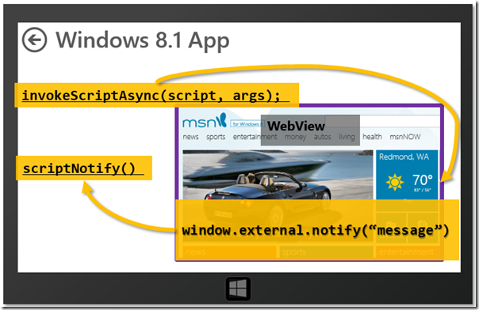
AddWebAllowedObject
Improved communication between Application and Web Content
Without AddWebAllowedObject

Slide 28
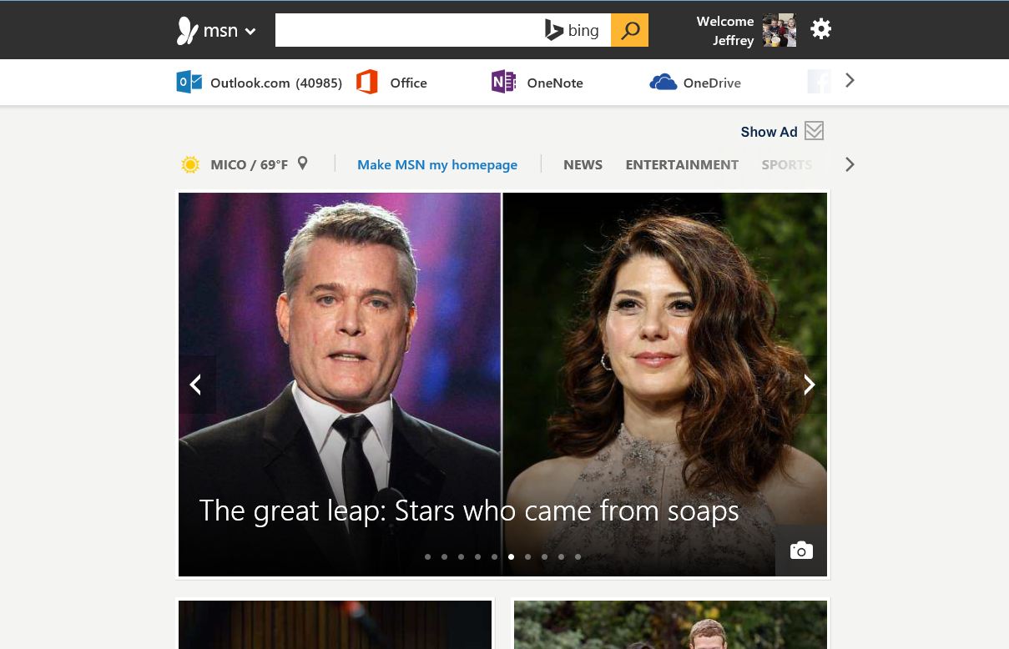
AddWebAllowedObject
Improved communication between Application and Web Content
With AddWebAllowedObject
Windows 10 App
C#/C++ --sharedObject() -- JS

Slide 29
WebView Control – New Event
New Window Event
Allows developers to handle content in WebView Attempting to open a new window
var webview = document.getElementById('WebView');
//Subscribe to Event
webview.addEventListener(" MSWebViewNewWindowRequested", handleNewWindow, false);
//Handle Event
function handleNewWindow(e) {
e.preventDefault();
//Navigate to the url in the webview
webview.navigate(e.uri);
}

Slide 30
WebView Control
Windows Universal API access using JavaScript
Just like hosted web apps, WebView can call APIs directly from web code
if (window.Windows){
// Create an appointment with Windows.ApplicationModel.Appointments.Appointment();
}

Slide 31
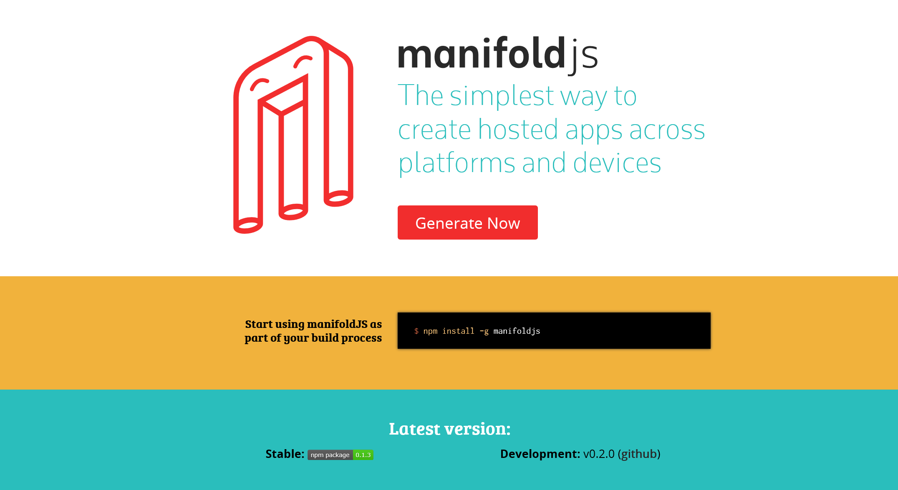
www.manifoldJS.com

Slide 32
“Real” Cross-Platform Development

Slide 33
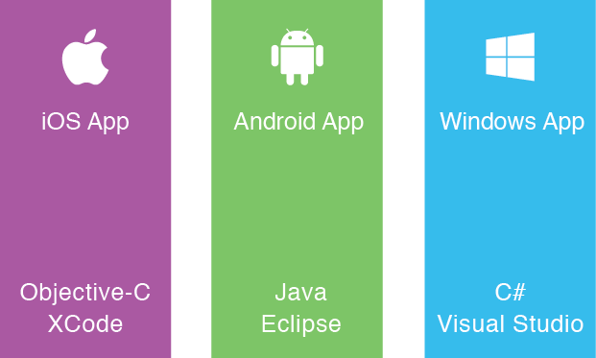
The Silo Approach
Build App
Multiple Times

Slide 34
The mobile strategy dilemma
End user
experience
+
Great apps delivered to the user’s choice of device
Development agility to move at mobile speed
-
+
Better TCO, productivity and
Developer Experience

Slide 35



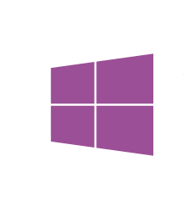

Microsoft supports your choice
.NET
Desktop apps
Universal Windows apps
Rich experiences
Breadth of devices
Browser-based applications
HTML

Slide 36
Cordova HTML/JS

Slide 37

Write-Once-Run-Anywhere Approach
Lowest
Common
Denominator
Black box

Slide 38





Web and extend apps
Web development with Visual Studio
CSS | HTML
JavaScript | TypeScript
Powerful IDE for HTML5 / CSS3.
Highly interactive JavaScript-based apps.
Suited for LOB browser-based apps.
+ Integrated extended app support
Black Box
Hybrid app build-in support with Cordova.
Full developer workflow for coding, debugging, and instrumenting device hybrid apps.
Visual Studio productivity for Android, iOS, and Windows devices.

Slide 39
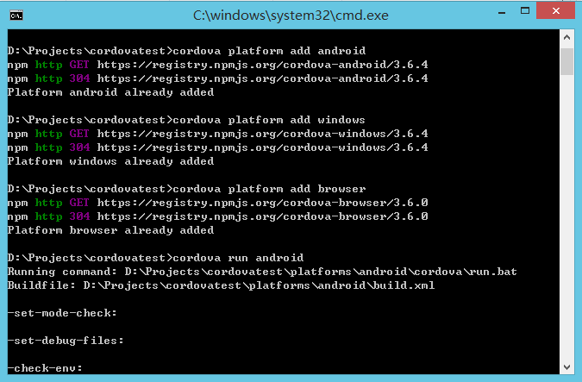
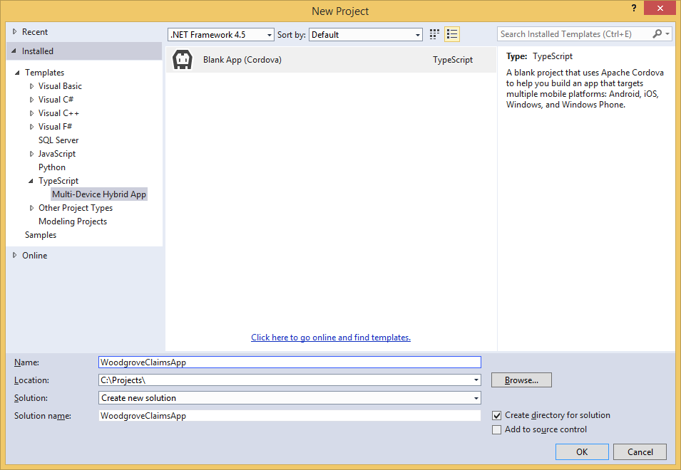
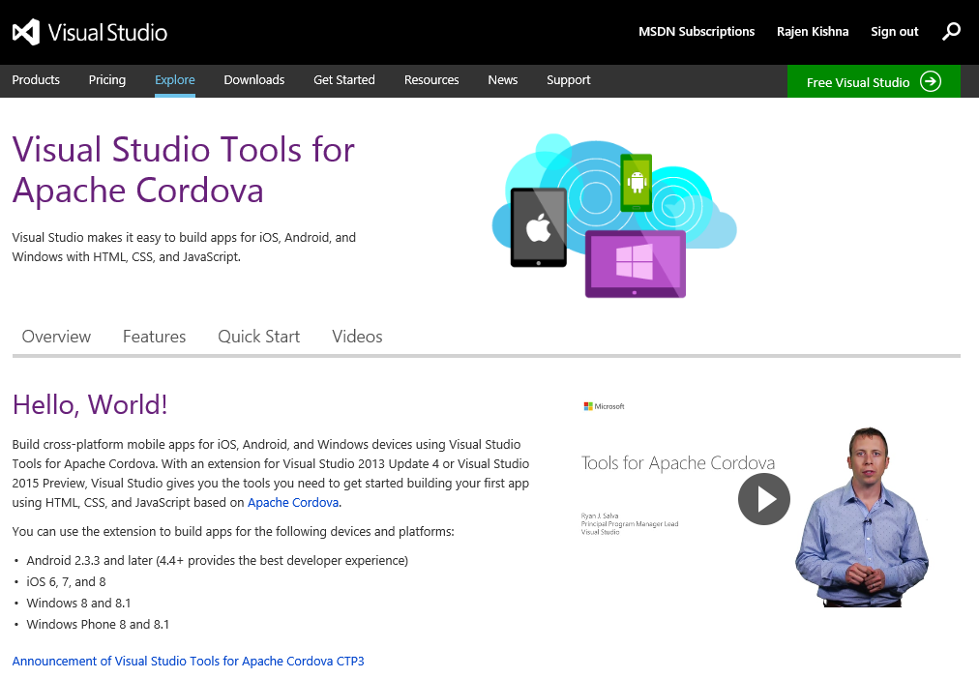
Getting started and samples
Use CMD
Use Visual Studio
Install Visual Studio Tools for Apache Cordova Extension
Read multiple samples based on open-source UI frameworks, including AngularJS, Backbone, or WinJS.
Start with JavaScript or TypeScript

Slide 40
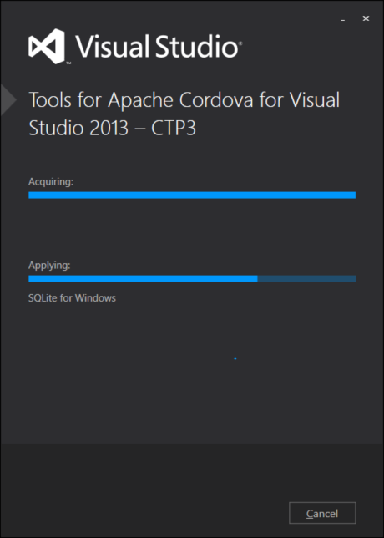

Slide 41









Framework
WinJS
jQuery Mobile
BackboneJS
Sencha Touch
Angular.js
Ionic
Others
jQTouch, Kendo UI, Wink Toolkit, Zepto, Jo, EmbedJS, DHTMLX Touch, Mobilise.js, Enjo.js, PhoneJS, iUI, Spine Mobile, WebApp.net, Dojo Mobile, etc.
Notes:
Apache Ant，是一个将软件编译、测试、部署等步骤联系在一起加以自动化的一个工具，大多用于Java环境中的软件开发。

Slide 42
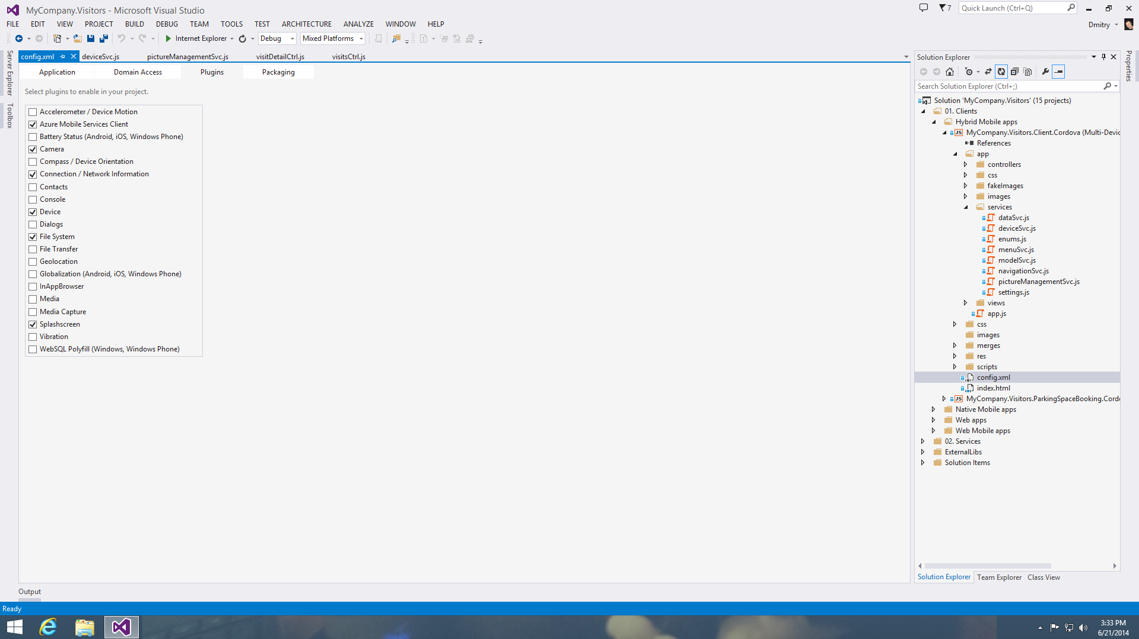

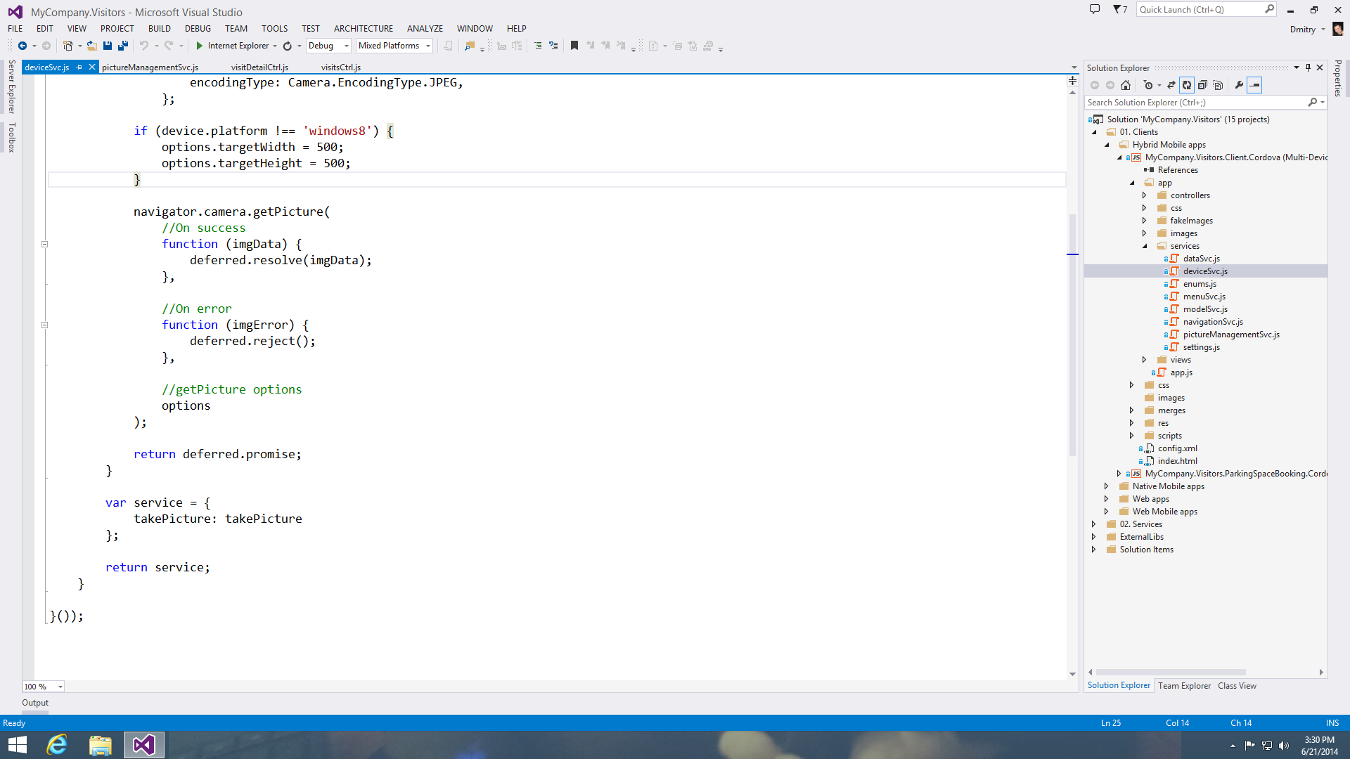
Using device capabilities
Use device capabilities from your app
Access device-specific capacities through plugins.
Out-of-the-box plugins include Geolocation, File System, Network, Media, and many more.
The rich Visual Studio JavaScript code editor makes working with plugins even easier with features such as colorization and IntelliSense.
Go further—plugin registry
Get more plugins to take your app further through the Apache™ Cordova plugin registry.
Notes:
Speaker Notes
More info on plugins: http://plugins.cordova.io

Slide 43
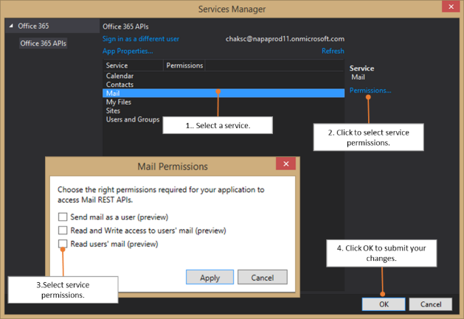
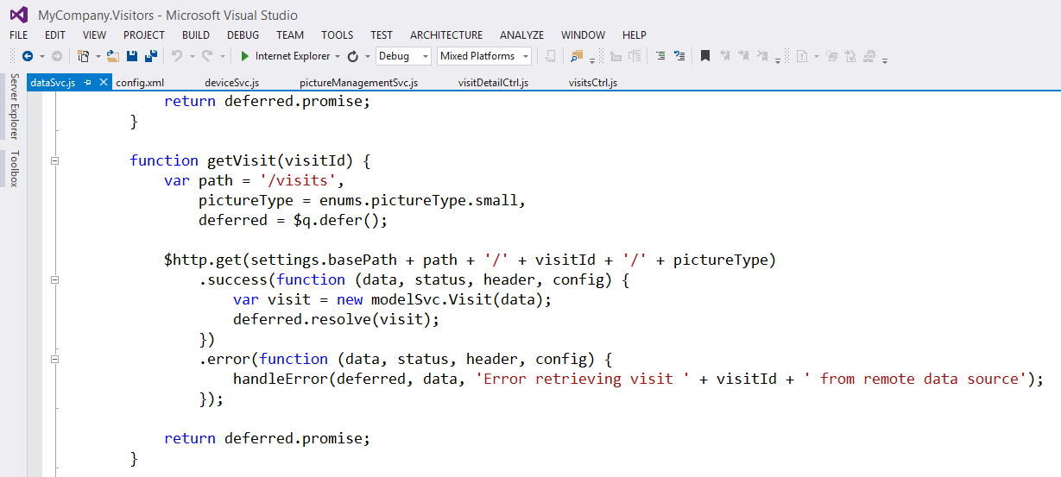

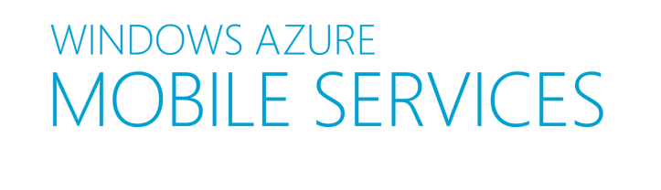

Integrating with services
Easy integration with Microsoft Services
Azure Active Directory—authentication.
Office 365—access data from Exchange and files.
Create custom services on Microsoft Azure
Create and use highly scalable end-points using Azure Mobile Services.
Publish and consume your own custom RESTful services, such as those built using ASP.NET Web API.
Auth
Server Logic
Notifications
Logging & Diag
Data
Scheduler
Scale
Notes:
Speaker Notes
Office 365 integration is made easier with a new Preview extension for Visual Studio called Office 365 API tools—Preview
http://visualstudiogallery.msdn.microsoft.com/7e947621-ef93-4de7-93d3-d796c43ba34f

Slide 44
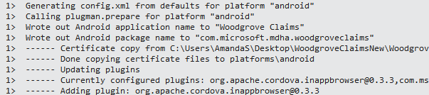
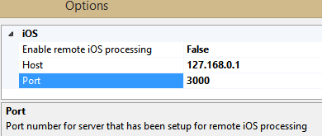
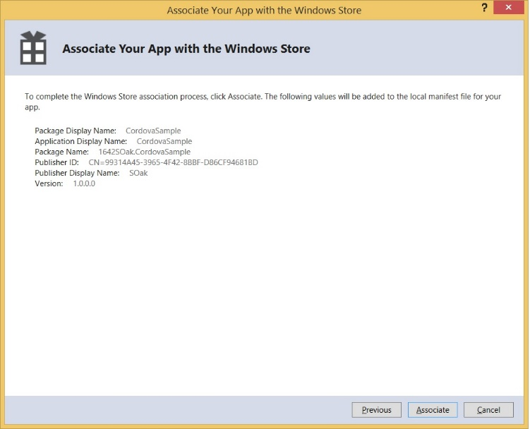
Building & Deploy
Build
Build your app right from Visual Studio.
Remote build to in-network OSX
Launch remote build agent.
Initiate deployment to iOS simulator.
Packaging the app for multiple platforms
Friction free, predictive, and consistent way of managing certificates and provisioning profiles.
Simple workflow to package your app for multiple platforms (Windows, iOS, and Android).

Slide 45
Cordova Tools Demo
Notes:
VS 2015 -> File New Project
Javascript – Cordova – Blank template
Config.xml – tabje plugins – battery toevoegen -> mapje erbij
Deploy Android emulator – wij native ondersteunen. Hyper-v oplossing.

Slide 46
Xamarin C#/XAML

Slide 47
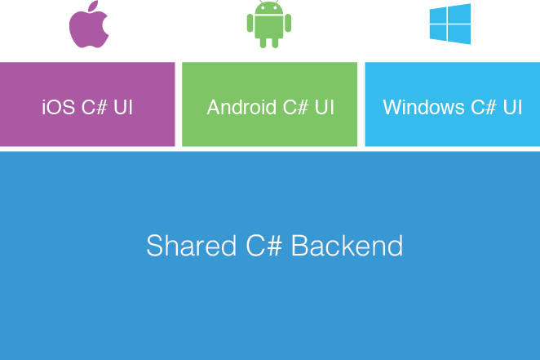
Xamarin’s Unique Approach
Native with Code Sharing
Shared C# Logic

Slide 48
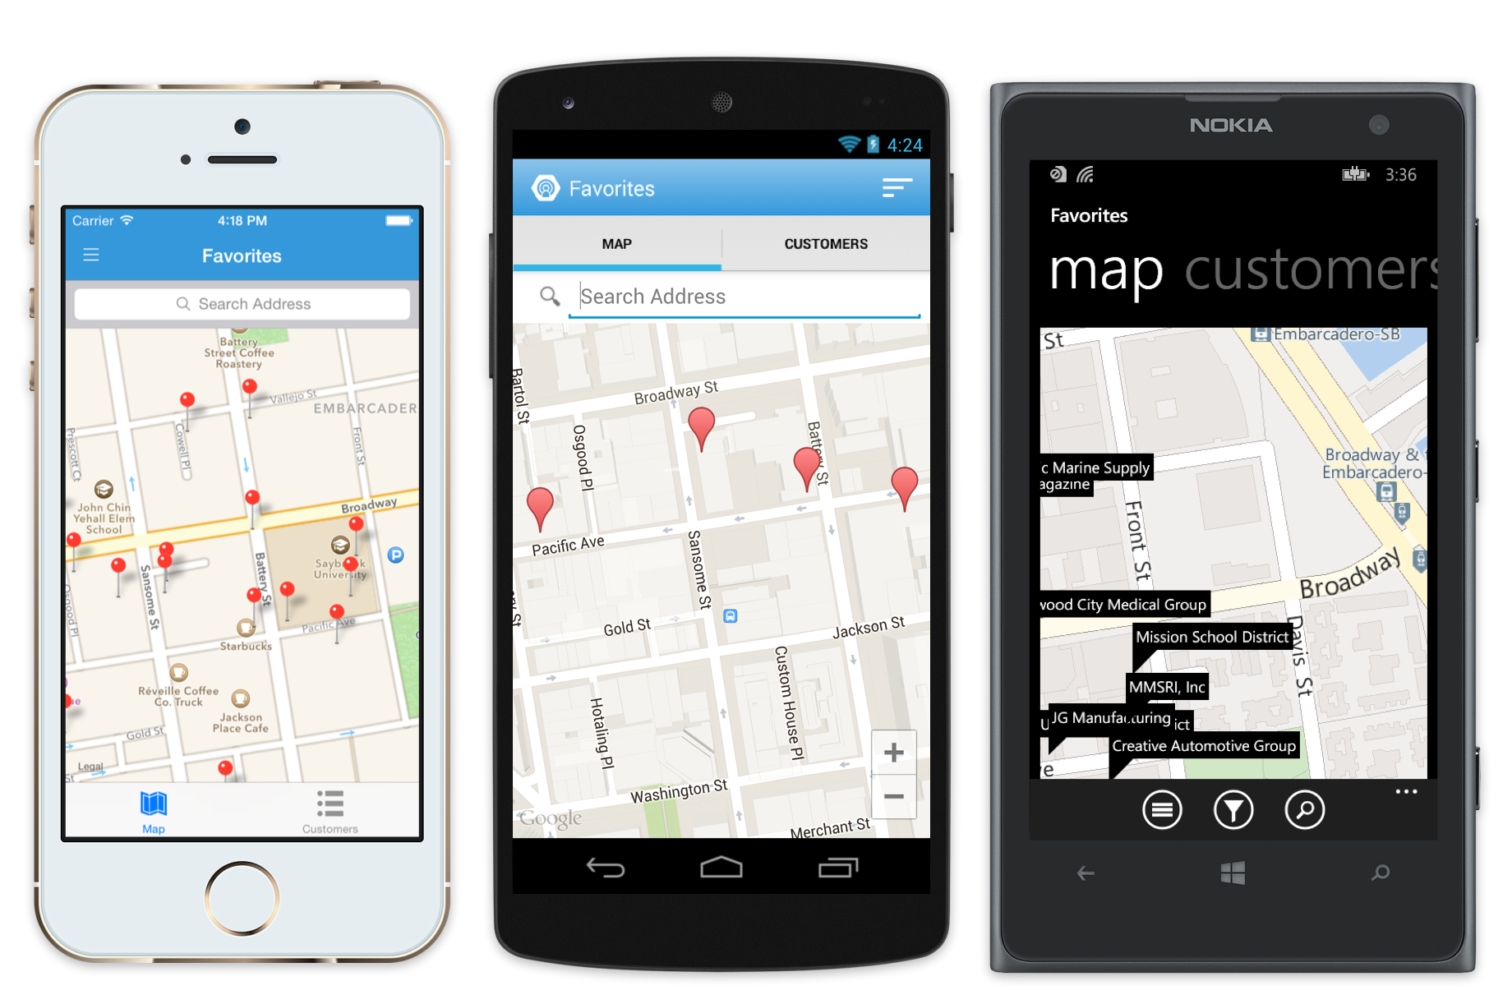
Meet Xamarin.Forms
Build native UIs for iOS, Android and Windows Phone from a single, shared C# codebase.

Slide 49
Xamarin + Xamarin.Forms
Shared UI Code
Shared C# Logic
Shared C# Logic
Traditional Xamarin Approach
With Xamarin.Forms:
More code-sharing, all native

Slide 50
What’s Included
40+ Pages, Layouts, and Controls
Build from code behind or XAML
Two-way Data Binding
Navigation
Animation API
Dependency Service
Messaging Center
Shared UI Code
Shared C# Logic

Slide 51
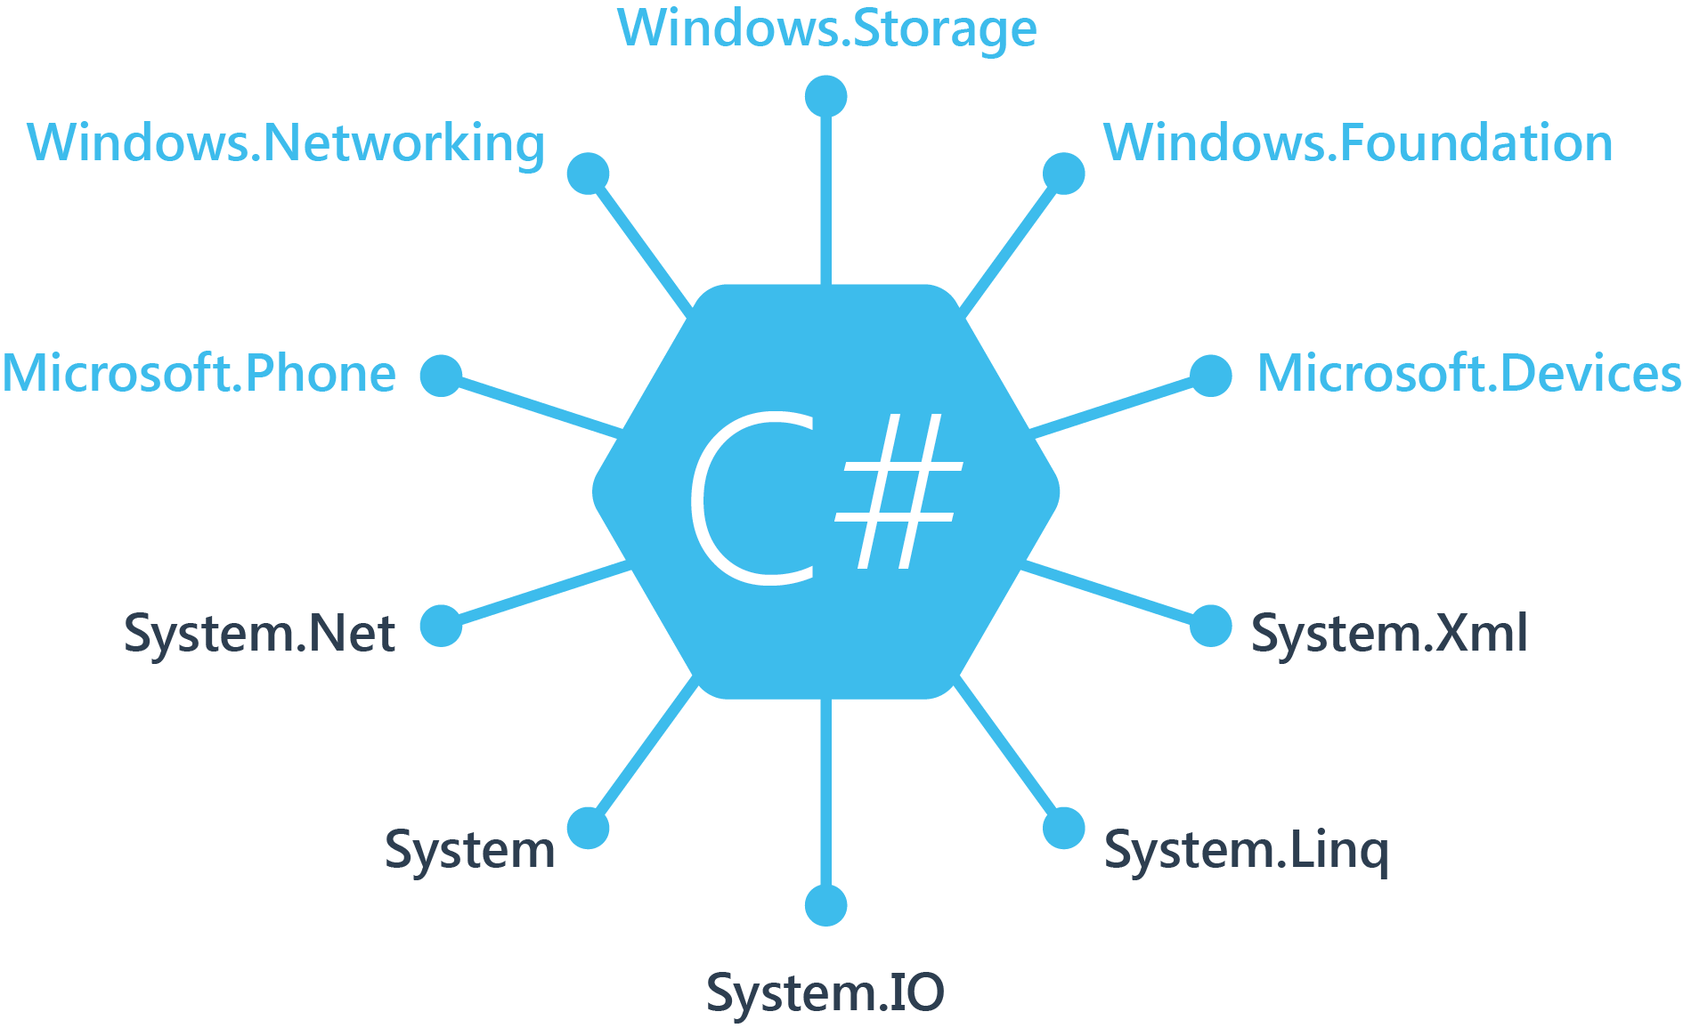
Windows APIs

Slide 52
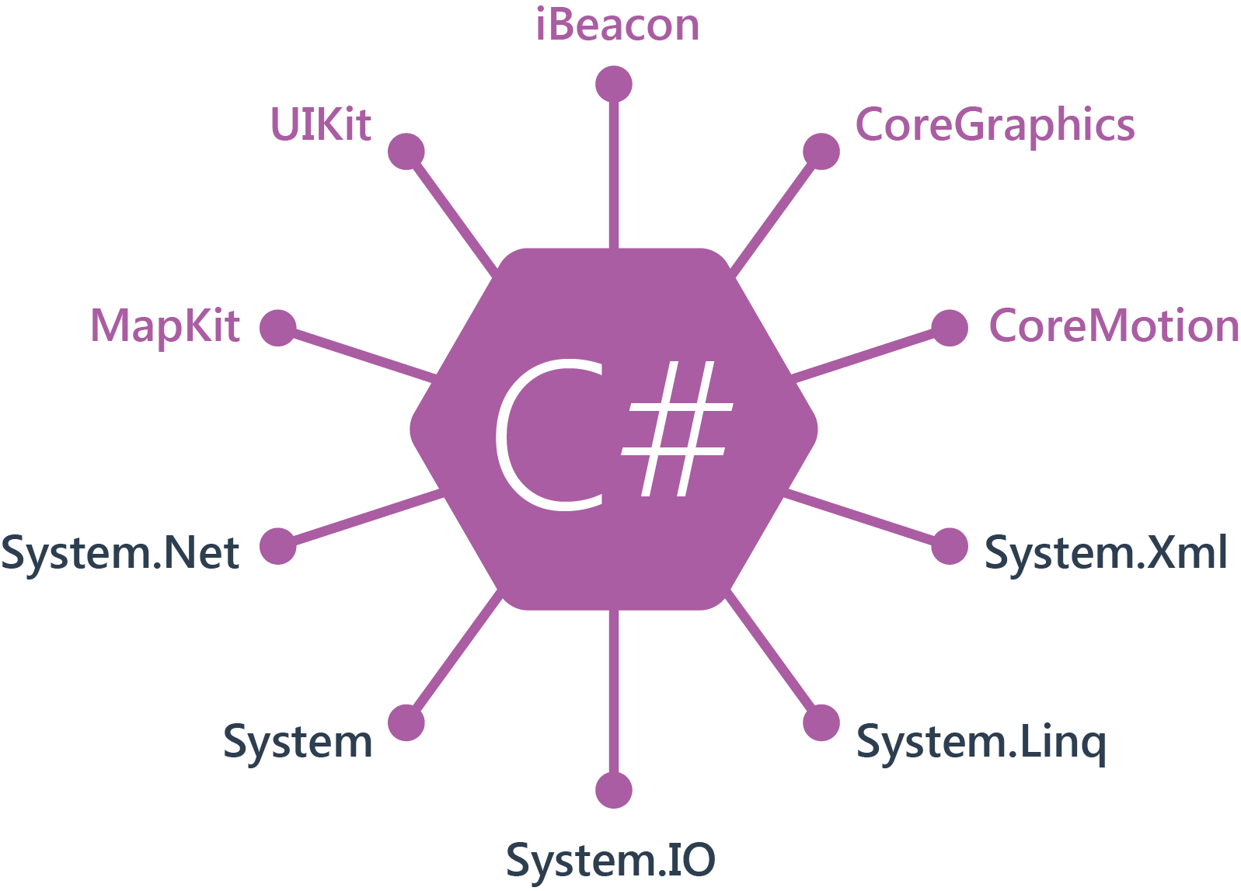
iOS
100% APIs Coverage

Slide 53
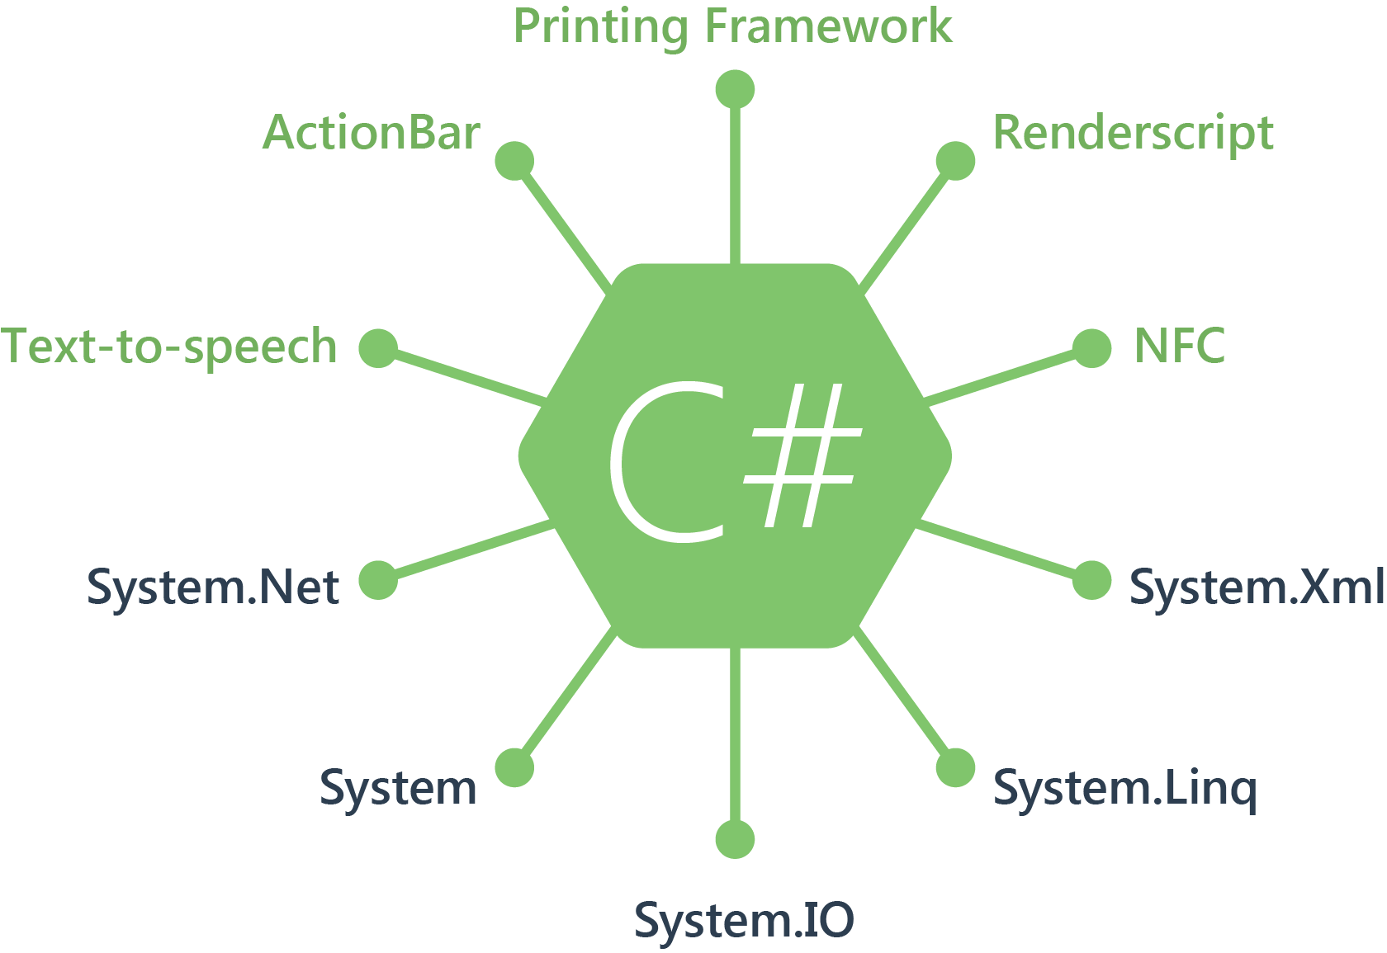
Android
100% APIs Coverage

Slide 54
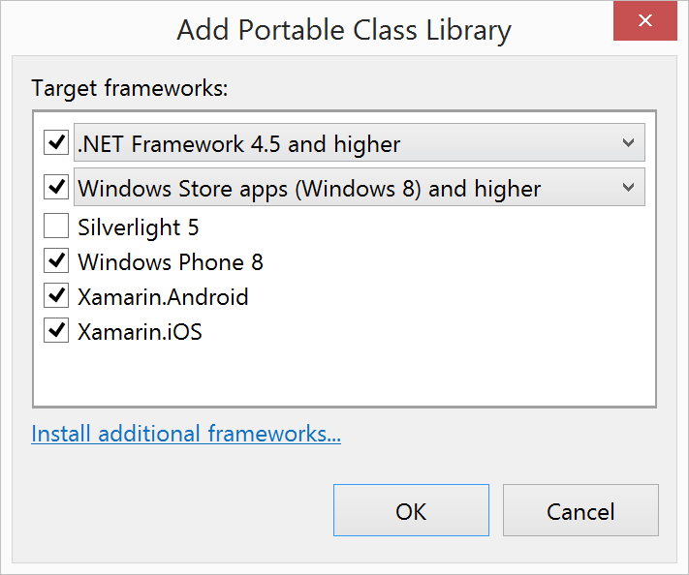
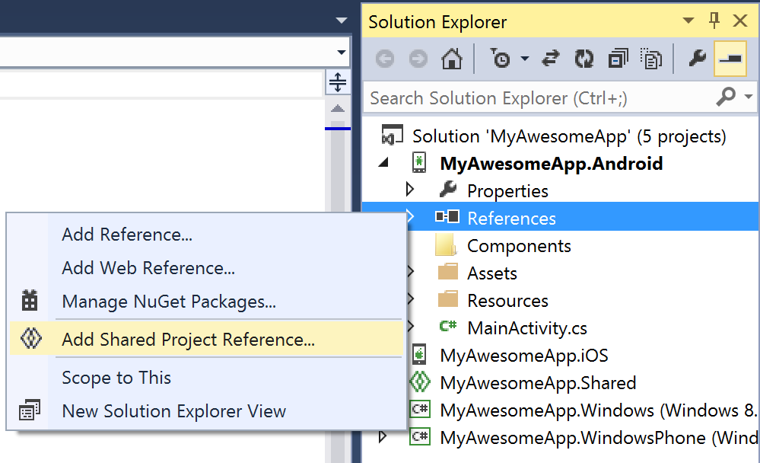
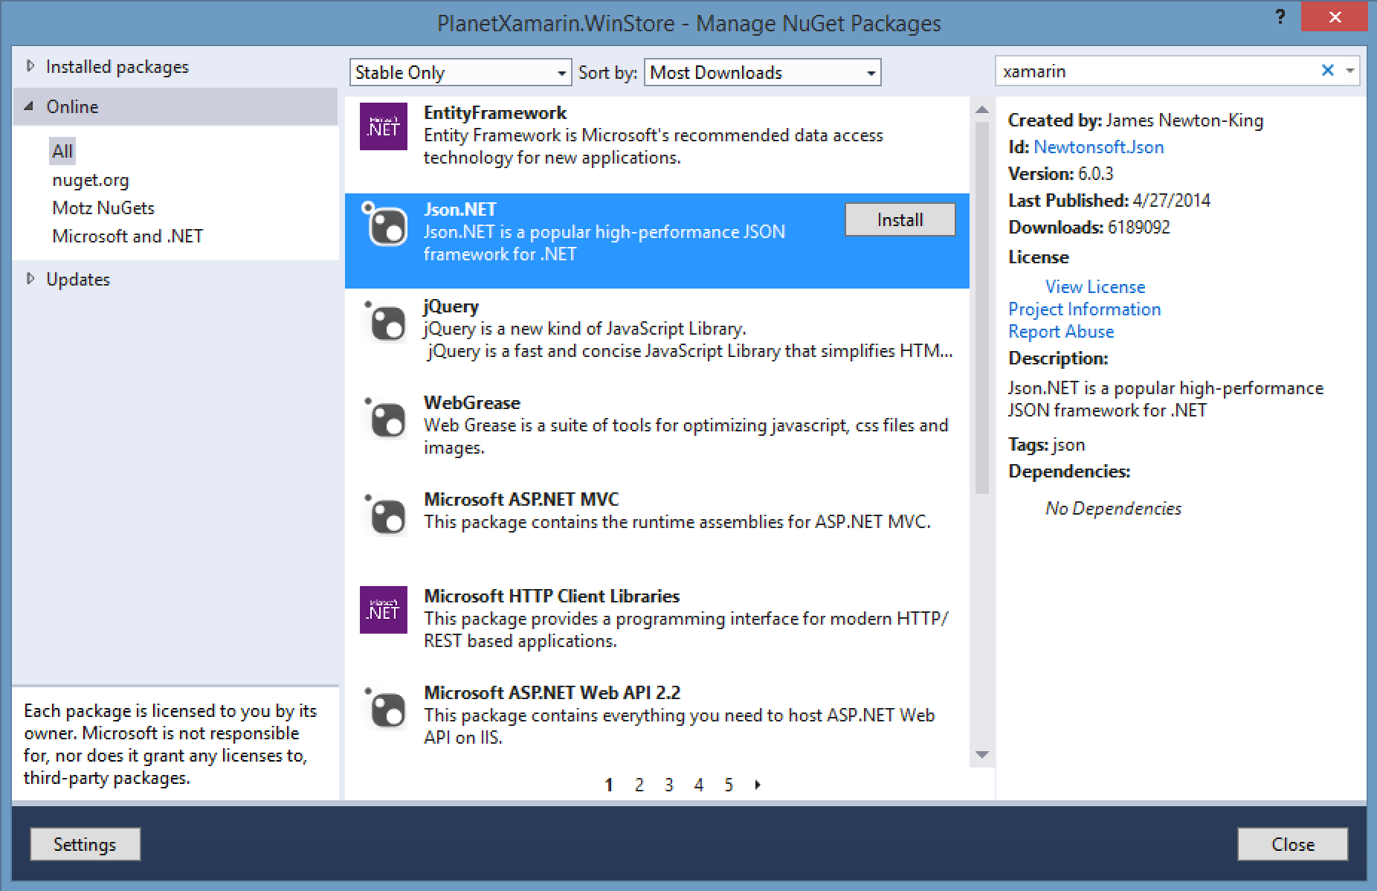
Sharing Code
Portable Class Libraries
Shared Projects
NuGet Support

Slide 55
Portable Class Libraries
1 Assembly
Multiple Platforms
Including:
Xamarin.iOS
Xamarin.Android

Slide 56
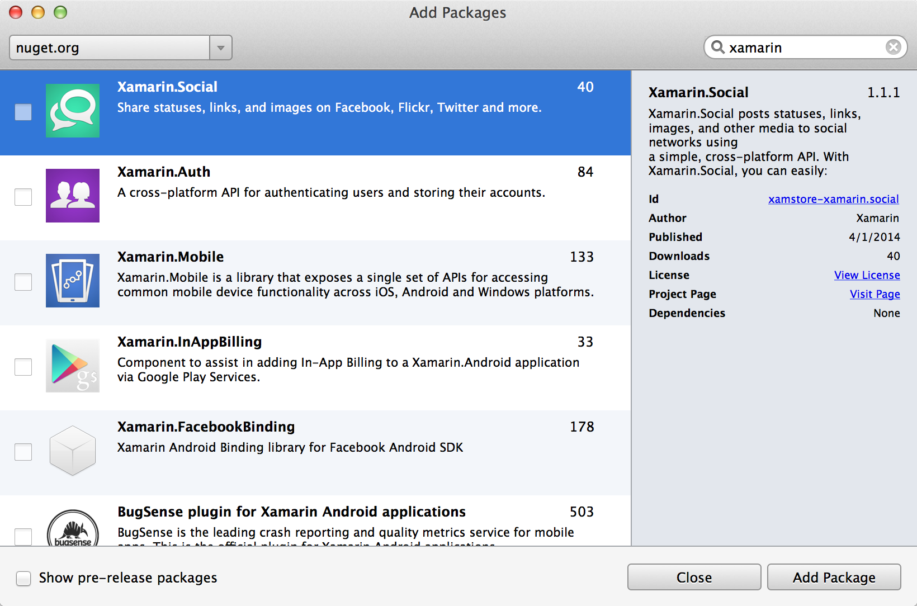
NuGet

Slide 57
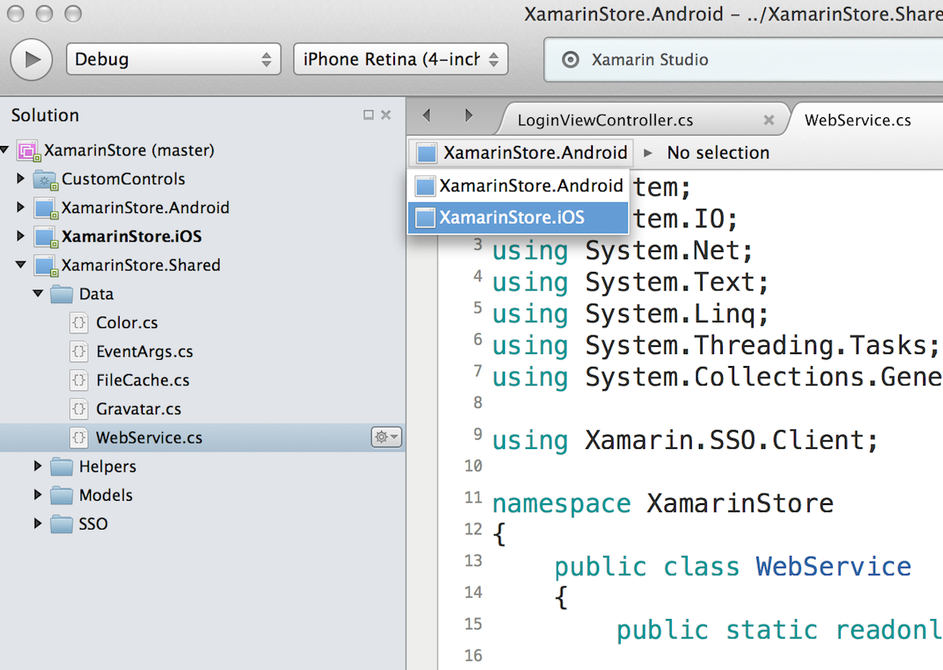
Shared Projects

Slide 58
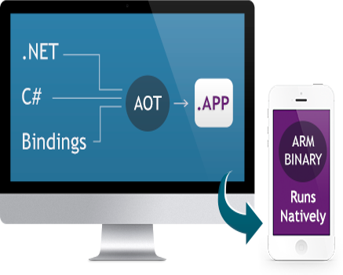
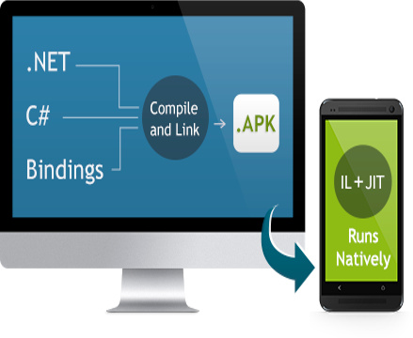
Native Performance
Xamarin.iOS does full Ahead Of Time (AOT) compilation to produce an ARM binary for Apple’s App Store.
Xamarin.Android takes advantage of Just In Time (JIT) compilation on the Android device.

Slide 59


Automatically test your app on thousands of real devices in the cloud.

Slide 60
Xamarin Demo
Notes:
MacOS – BuildHost starten (grijze zesoek)
Windows – VS Parkeren DenHaag solution
Portable class library
Storyboard iOS openen -> via BuildHost
Bijbehorende class ViewControlers
Debug (via details page -> breakpoint)

